Slide 1
Web Scraping and Analysis
Presenting insights

Slide 2
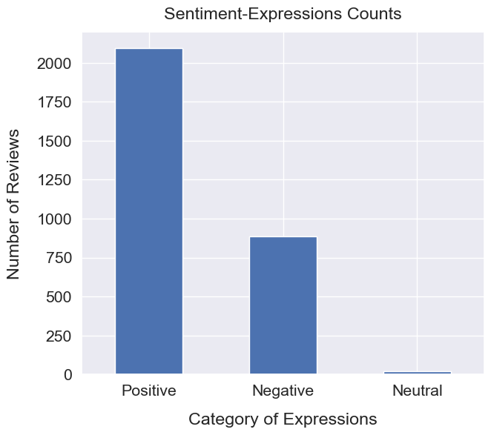
Sentiment Analysis
The Sentiment Analysis shows that out of 3,000 reviews from British Airways Customers, 2,092 reviews are Positve, 887 reviews are Negative, and 21 reviews are Neutral.
69%
Positive
29%
Negative
0.7%
Neutral

